Slide 1
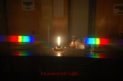
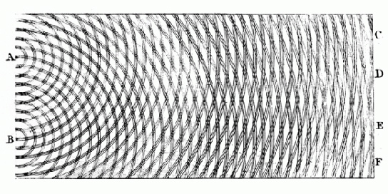
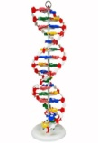
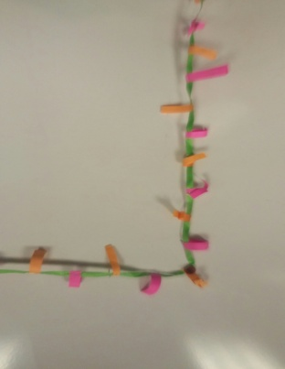
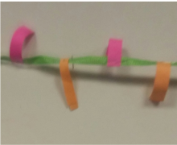
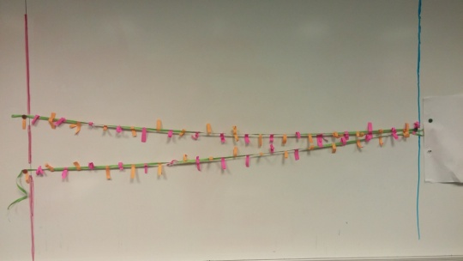
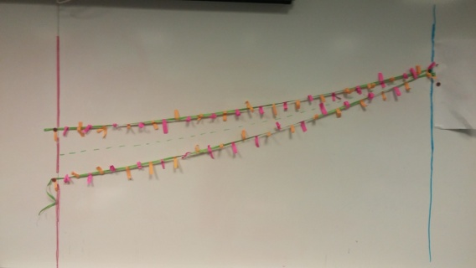
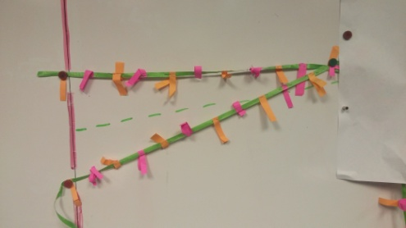
If your students are like mine, depictions like this …..
A Cheap and Easy ‘Do It Yourself’ Young’s Double Slit Experiment Demo Piece
John Avallone, Physics Teacher, Stuyvesant High School
Master Teaching Fellow, Math for America, NYC
PROBLEM:
Understanding the double slit can be an essential stepping stone to understanding diffraction gratings, thin films, and any other path length related phenomena.
are a baffling mess that help very little in understanding Diffraction and Interference in the context of Young’s Double Slit Experiment…..
But there is too much at stake to just hope to get by with some hand-waving and hoping they will “get it” and apply the equation mλ=d(sinθ)…………
this tool, with “wavelength-spaced” pink tabs representing “peaks” and tangerine tabs representing “troughs” provides an eye-catching and easy-to-follow guide for students to look at during a lecture
To help students visualize the key point, that there are points in space to which the path lengths from the two sources differ by either integer multiples of λ or odd-integer multiples of λ/2, a simple tool can be crafted.
Made of some ribbon and some alternating colored paper tabs (stapled to the ribbon)…….
λ
Central maximum
First Minimum
Fodder for Advanced Discussion…
Top path is “countable” as 15.5 wavelengths. Bottom path also countable. Look how wave that is in phase at the slits is also in phase at the screen. “Pink on Pink”!
screen
15.5λ
12λ
15λ
13λ
15.5λ
9λ
14λ
10λ
1λ
2λ
3λ
11λ
4λ
5λ
6λ
3λ
4λ
5λ
6λ
7λ
d
7λ
8λ
8λ
9λ
10λ
11λ
12λ
13λ
14λ
15λ
1λ
2λ
Paper also held up with magnets, allows length of ribbon beyond the “screen” to be obscured.
Count along the bottom path to find it is 16λ And look! Waves that were in phase at the slits are out of phase (Pink on Tangerine) at the screen. Imagine the scene one-half period later (or just advance both ribbons by λ/2) and see we still have destructive interference.
By shortening the ribbon, we see that we still get the first minimum where the top path is one half λgreater than the bottom path, but the angle to that minimum is not the same as what we found when the paths were longer… (green dashed line vs. red) but the equation would imply they should be…. Why……..?
Magnets hold the ribbon to the board.
I have found that this device, along with actual demonstrations of the double slit (and subsequently diffraction grating) can lead student to a conceptual understanding of how and why maxima and minima appear in those cases. Less useful for “single slit” in my experience…..
This brings up a nice opportunity to discuss, or re-discuss, the basic assumptions of the equation, and point out how the demonstration piece does not reflect the enormous disparity of “L” to the screen as compared to d and λ that one finds in “real life”.
Please note that John Avallone is a high school teacher, and as such loans, borrows and donates ideas without attribution or citation. As much as I believe this idea originated in my head, I don not wish to claim or certify that I have researched it to be “original”. Apologies to any others who may claim simultaneous discovery, or to those who choose to be offended by its similarity to any commercially available product, pre-existing similar device, etc.

